Slide 1
Employee Data Analysis using Excel
STUDENT NAME:
REGISTER NO:
DEPARTMENT:
COLLEGE
KASIN PRADHISHA R
312209997
B.COM GENERAL
VALLIAMMAL COLLEGE FOR WOMEN

Slide 2
PROJECT TITLE
Employee Performance Analysis using Excel

Slide 3


AGENDA
Problem Statement
Project Overview
End Users
Our Solution and Proposition
Dataset Description
Modelling Approach
Results and Discussion
Conclusion
3/21/2024 Annual Review

Slide 4

PROBLEM STATEMENT
problem statement for using Excel in employee performance analysis might be: "Our organization needs a systematic way to evaluate employee performance based on productivity, attendance, and goal achievement. We aim to use Excel to consolidate data from multiple sources, generate performance reports, and identify areas for improvement to enhance overall workforce efficiency."

Slide 5

PROJECT OVERVIEW
To develop a comprehensive employee performance analysis tool using Excel that allows for the tracking and evaluation of key performance metrics.
Gather data on productivity, attendance, goal achievements, and other relevant metrics.
A detailed Excel workbook with multiple sheets for data entry, analysis, and reporting.
Dashboards and charts that provide visual insights into employee performance.
Regular performance reports summarizing key findings and recommendations.

Slide 6

WHO ARE THE END USERS?
The end users of Excel can vary widely depending on the context, but they typically include:
1. Business Analysts
Use Case: Analyze data, create reports, and generate insights for decision-making.
Tasks: Financial modeling, forecasting, data visualization, and scenario analysis.

Slide 7

OUR SOLUTION AND ITS VALUE PROPOSITION
Problem: Sales teams at a mid-sized company are spending too much time manually generating reports and analyzing sales data. This manual process is prone to errors, inconsistent data formatting, and delays in providing actionable insights to management

Slide 8
Dataset Description
dataset description provides details about the data collected in a dataset, including its contents, structure, and purpose. It usually includes:
Data Source: Where the data comes from (e.g., surveys, experiments, web scraping).
Data Type: The format of the data (e.g., numerical, categorical, text).

Slide 9
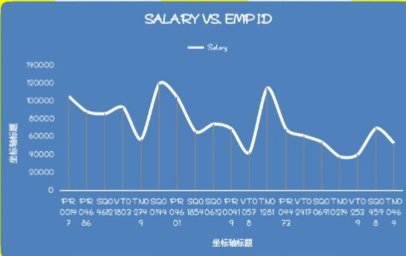

THE "WOW" IN OUR SOLUTION
3/21/2024 Annual Review
9

Slide 10
MODELLING
Modeling in Excel refers to the process of creating a mathematical or statistical representation of a real-world scenario, which can be used to analyze, predict, or optimize outcomes. Excel is a powerful tool for building such models because of its flexibility, built-in functions, and ability to handle complex calculations
10

Slide 11
RESULTS
11

Slide 12
conclusion
When wrapping up any analysis, project, or presentation in Excel, the conclusion should succinctly summarize the key insights, findings, and recommendations. It should also provide a clear direction for the next steps or actions based on the analysis. Here’s how you can effectively craft a conclusion in Excel:

